Slide 1


IoT WorkPlace Use Case
Vivek Bharatia

Slide 2
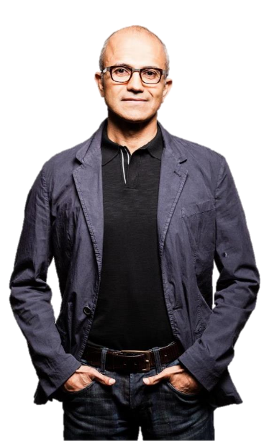
Digital transformation is reshaping the landscape
“Every business will become a software business, build applications, use advanced analytics and provide
SaaS services.“
- Satya Nadella
~80%
driven by apps,
analytics, and
services in 2020
Intelligence
margin¹
Average increase in income for the most digitally transformed enterprises
$100M
²
Income
2020
30B
²
Things
2009
Sources:
¹McKinsey, How IoT Can Support A Dynamic Maintenance Program, 2016
²IDC, 2016

Slide 3
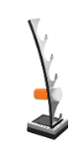
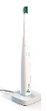



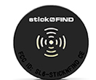


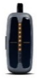

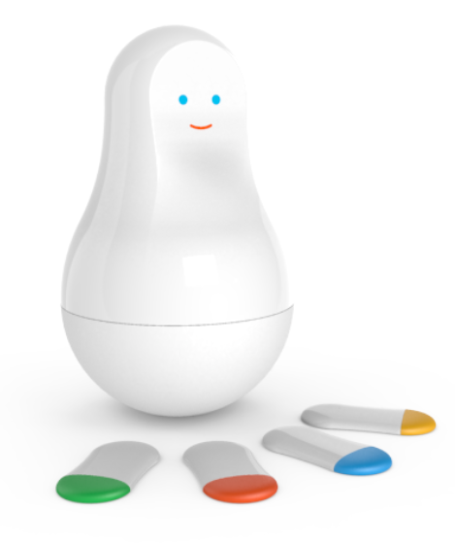








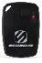
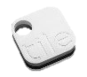





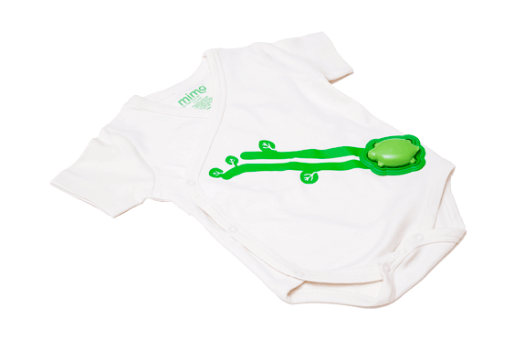
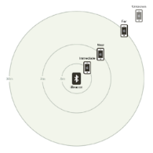
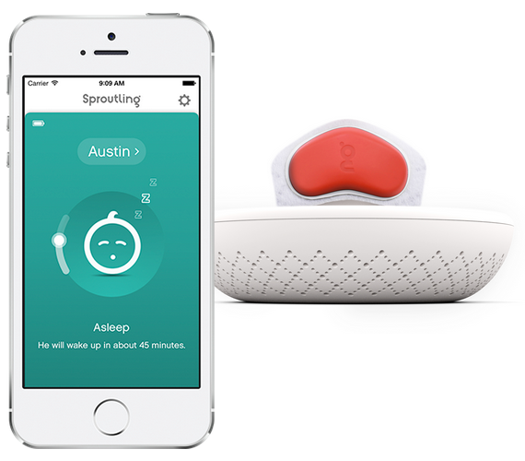

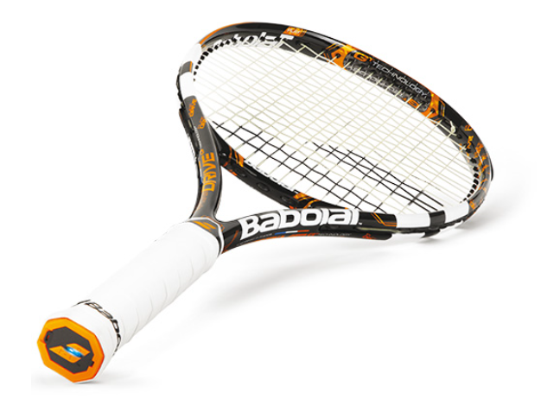

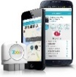












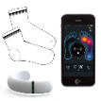





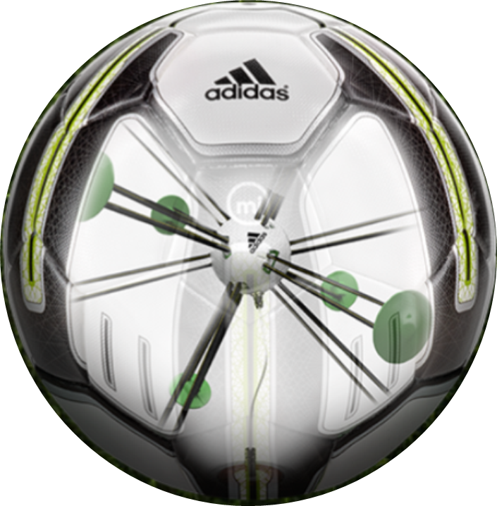



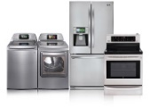
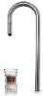
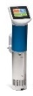
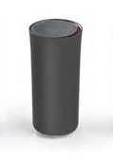

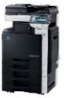
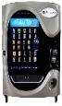


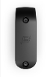

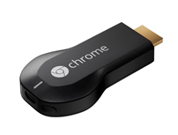




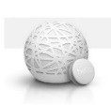
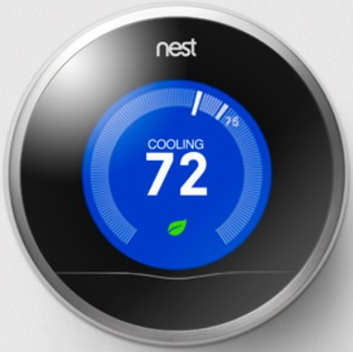
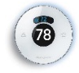
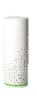

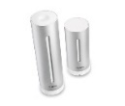






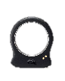



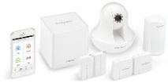
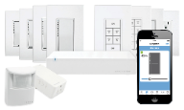
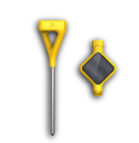
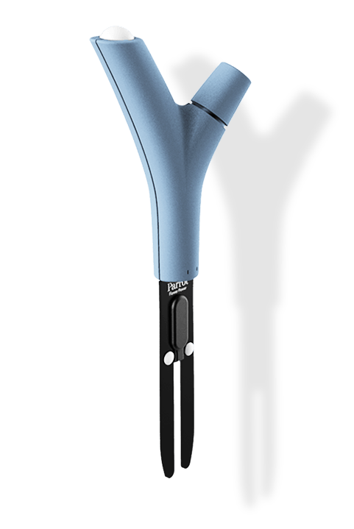

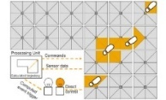
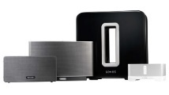






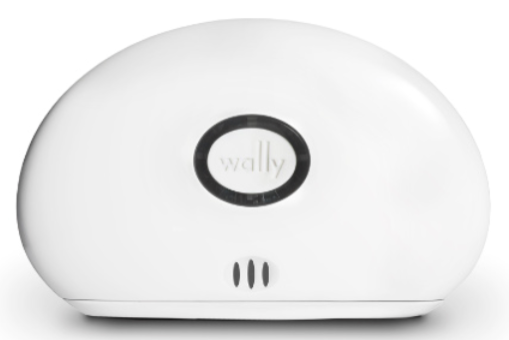

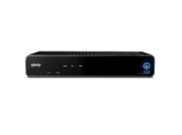
Today!
IoT –Connecting your workplace
Medication adherence
Health monitoring
Pet tracking
Behavior modification
Object tracking
Child and elder
monitoring
Sports
and fitness
Indoor
navigation
Trip tracking and car health
Smart lighting
Beacons
and proximity
HOME
WORKPLACE
HOME
Smart appliances
Food and nutrition tracking
Identity
Office equipment
Smart vending machines
Bike ride stats and protection
Air conditioning and temperature control
Sleep tracking
Environmental sensors
Information capture
Control
Home security
Home automation
Leak detection
Garden, lawn and plant care
New devices and sensors
Entertainment systems
Notes:
Anyone that is not connected somehow?

Slide 4
Microsoft offers a broad IoT portfolio
Intelligent
Devices
Intelligent Connectivity
Intelligent
Insights
Intelligent
Actions
Windows 10 IoT
Azure IoT Suite
Cortana Intelligence Suite
Xamrin /Apps

Slide 5
End-to-End Microsoft IoT Solution
On-Premises
Sensors and Things
Data generation
Basic security/mgmt
Very low cost/high volume
Smart Devices
Data aggregation/prep
Robust security/mgmt
Mid range cost/volume
Industry Devices
Heavy data processing
Ent security & mgmt
High cost/Low volume
Servers
Data aggregation/prep
Secure cloud connection
Very high cost/Low volume
Cloud
Works With Windows
Works On Windows
Works With Windows

Slide 6
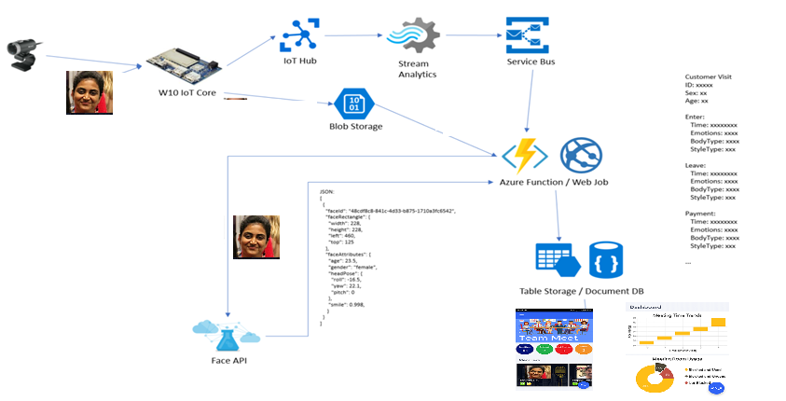
Use Case demo
Notes:
Walkthrough...

